Slide 1
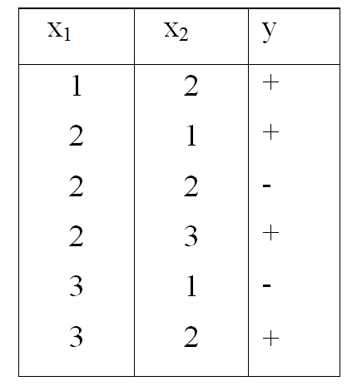
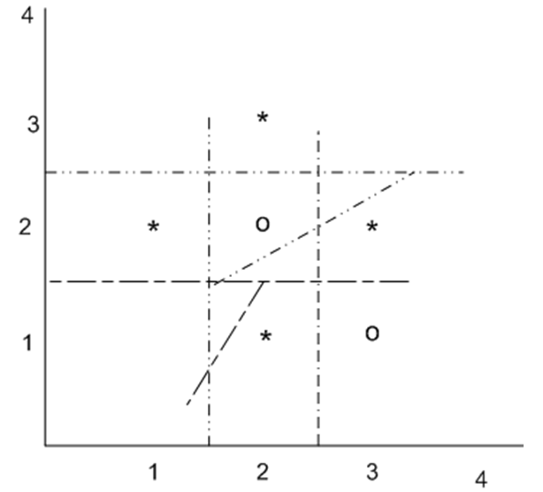
3-nearest neighbor decision boundary

Slide 2
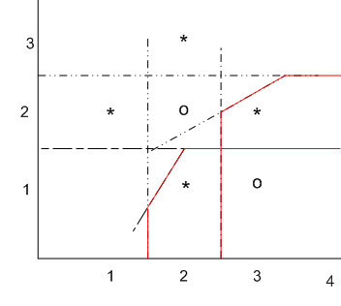
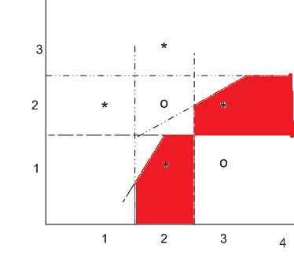

Slide 3
Locally-weighted Regression
Basic idea:
k-NN forms local approximation to f for each query point xq
Why not form an explicit approximation f (x) for region surrounding xq
Fit linear function to k nearest neighbors
Fit quadratic, ...
Thus producing ``piecewise approximation'' to f

Slide 4
f1 (simple regression)
Locally-weighted regression
f2
Locally-weighted regression
f3
Locally-weighted regression
f4
Training data
Predicted value using simple regression
Predicted value using locally weighted (piece-wise) regression

Slide 5
f1 (simple regression)
Locally-weighted regression
f2
Locally-weighted regression
f4
Several choices of error to minimize:
e.g Squared error over k nearest neighbors
or Distance-weighted square error over all neighbors
or …..

Slide 6
Locally Weighted Linear Regression
Using linear function to approximate f:
Recall from previous course: (Skip slides 7 to 12)

Slide 7
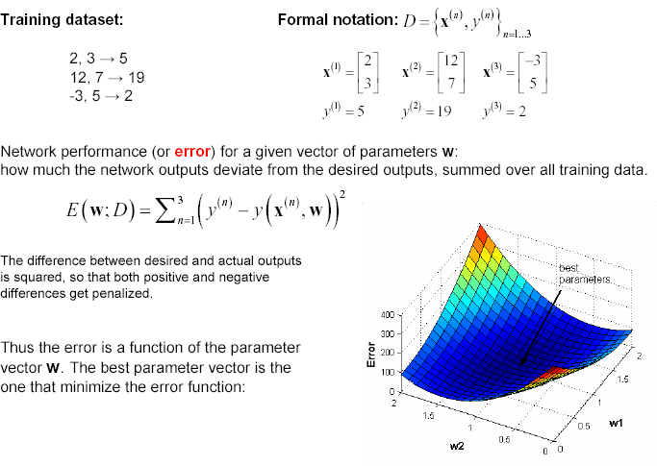
ERROR SURFACE

Slide 8
X= [2 3; 12 7; -3 5];
y = [5 19 2];
w1 = 0:0.1:2;
w2 = 0:0.1:2;
for p1 = 1:length(w1)
for p2 = 1:length(w2)
err(p1,p2) = 0;
for n = 1:3
% compute network output for example n
ynet = w1(p1)*X(n,1) + w2(p2)*X(n,2);
% update total error
err(p1,p2) = err(p1,p2) + (y(n) - ynet)^2;
end;
end;
end;
% plot error function
surf(w1,w2,err);

Slide 9


Learning by Error Minimization
We like to minimize the squared error (which is a function of the weights), for each training pair/pattern:
Square makes error positive and penalizes large errors
1/2 just makes some of the maths easier
The total error will be the sum of errors across all patterns
Need to change the weights in order to minimize the error
– Use principle of gradient descent - Calculate derivative (gradient) of the Error with respect to the weights, and then change the weights by a small increment in the opposite direction to the gradient

Slide 10
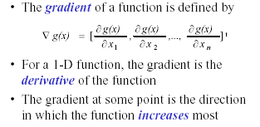
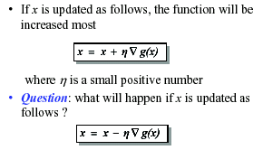
The gradient Descent Optimization
Direction of steepest descent

Slide 11
The components of the gradient vector are
d = t

Slide 12
Example 1
X₁=[1 –2 0 –1]¹, X₂=[0 1.5 -.5 -1]¹, X₃=[-1 1 .5 -1]¹
d₁ ⁼ ⁻1 d₂ ⁼ ⁻1 d₃ ⁼ 1
^{w1=[1 -1 0 .5];}
Net1=net1=[1 -1 0 .5]*[1 -2 0 -1]'=2.5
w₁
_{w2}
o
w₃
w₄
Complete this problem for one epoch

Slide 13
Locally Weighted Linear Regression(cont.)
Three possible error criteria:
Choose criterion 3 and get gradient descent training rule:
Other methods to directly solve for w₀…w_{n}
Atkeson et al.(1997), Bishop(1995)

Slide 14
Remarks on Locally Weighted Regression
In most cases, the target function is approximated by a constant, linear, or quadratic function.
More complex functional forms not often found
High cost
Simple approximations are quite well

Slide 15
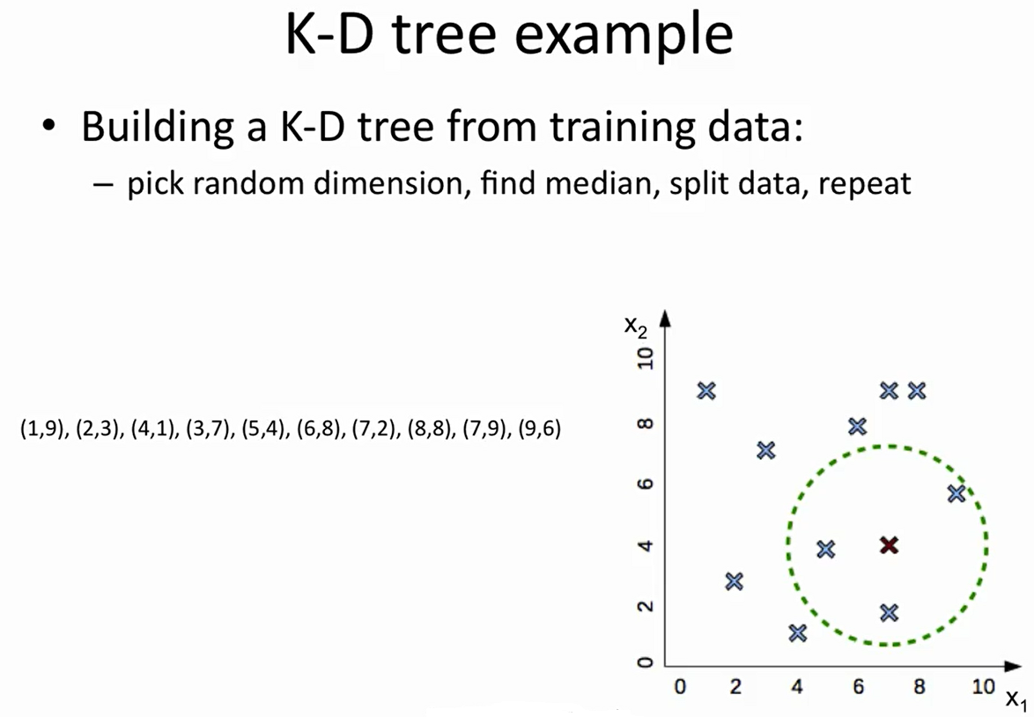

Slide 16
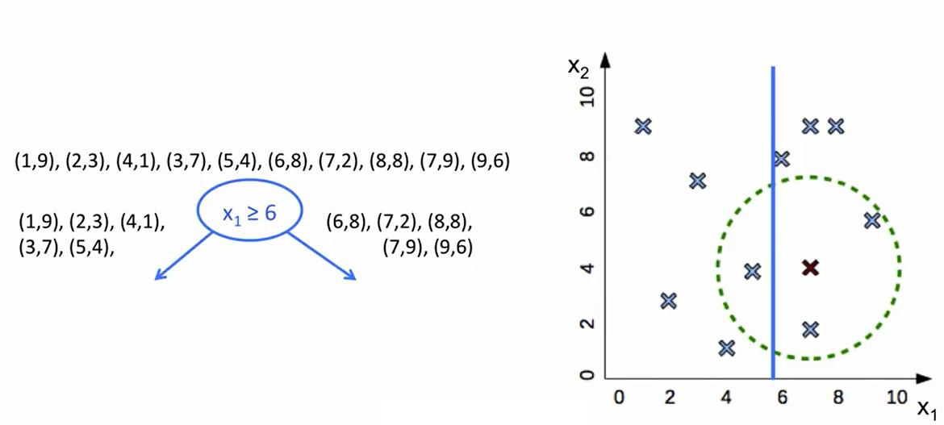

Slide 17
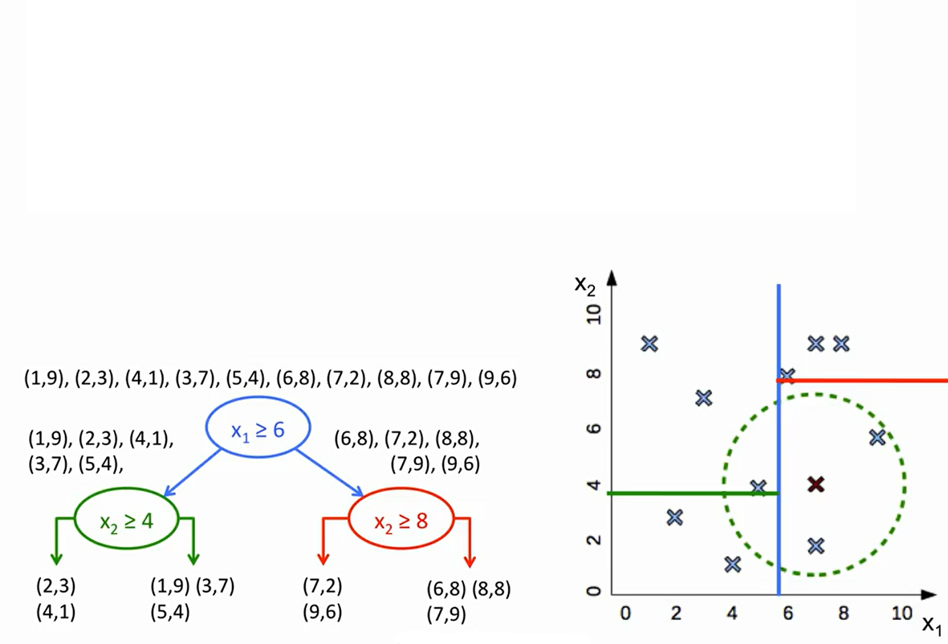
NN algorithm delays all processing until a new query is received, significant computation can be required to process each new query.
Various methods have been developed for indexing the stored training examples so that nearest neibhors can be identified efficiently. (Mitchel- page 236)

Slide 18
Lazy learning methods defer the decision of how to generalize beyond the training data until each query instance is encountered.
Eager learning method generalizes beyond the training data before observing the new query, committing at training time to the network structure and weights that define its approximation to the target function.

Slide 19

https://archive.ics.uci.edu/ml/datasets/lenses

Slide 20
